Slide 1


Exploring the Use of Deep Learning for Feature Location
Chris Corley
The University of Alabama
Kosta Damevski
Virginia Commonwealth University
Nick Kraft
ABB Corporate Research

Slide 2
Background
Static Feature Location Technique (FLT)
ICSME’15 ERA

Slide 3


Goals
Performance Gains without Accuracy Losses
ICSME’15 ERA

Slide 4
Deep Learning
Class of neural networks
Captures complex statistical patterns:
Captures context for each term occurrence
Encodes semantic relationships
Examples:
King – Man + Woman = Queen
Eiffel Tower – Paris + London = Big Ben
ICSME’15 ERA

Slide 5
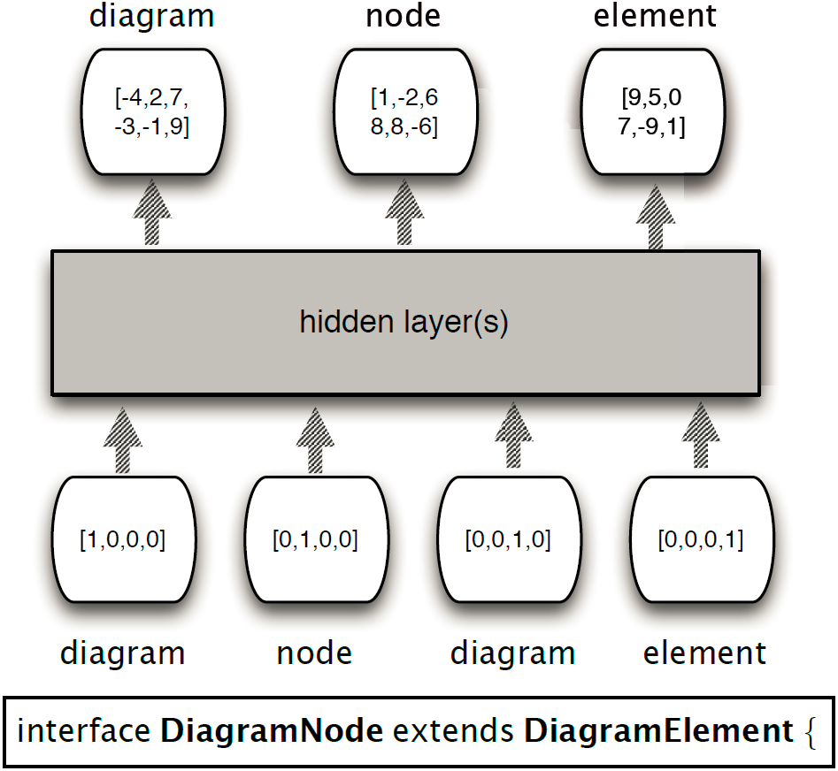
Layers for Source Code
ICSME’15 ERA

Slide 6
Examples from ArgoUML
save = saved
file + save = { exists, saved }
explorer + diagrams – creating = { nodes, deletion }
ICSME’15 ERA

Slide 7
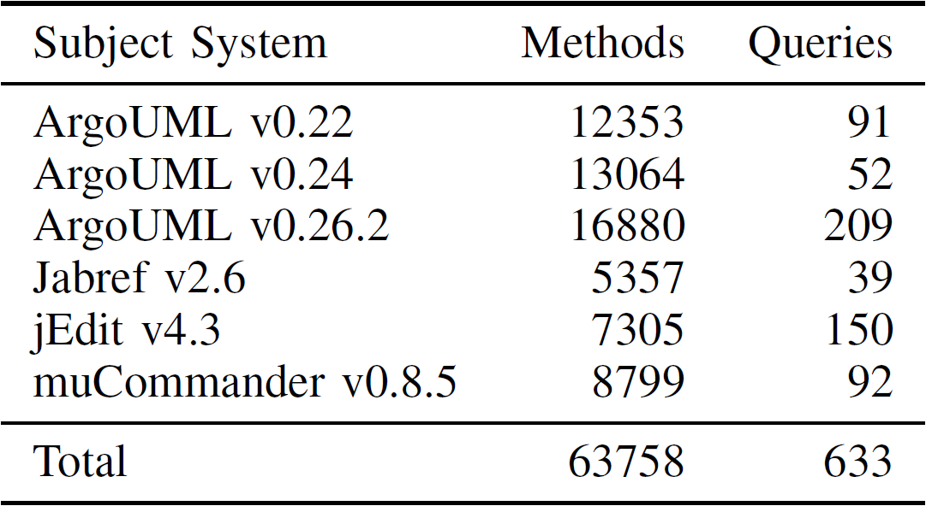
Preliminary Study
Dit, Holtzhauer, Poshyvanyk, Kagdi, “A dataset from change history to support evaluation of software maintenance tasks,” MSR 2013.
ICSME’15 ERA

Slide 8
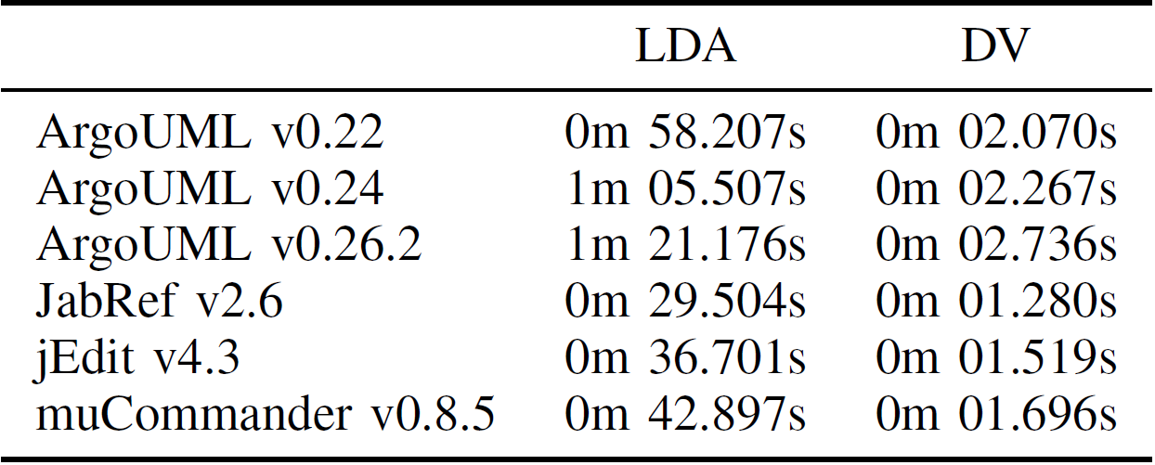
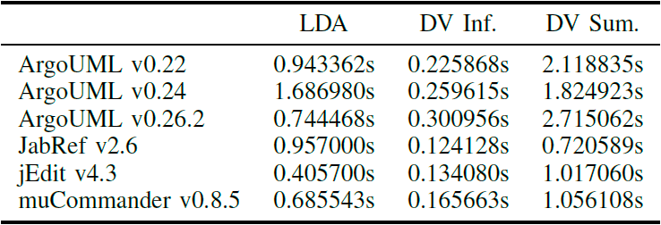
Preliminary Study
Results: Speed
ICSME’15 ERA
Notes:
DV Inf: Document level
DV Sum: Word level
LDA

Slide 9
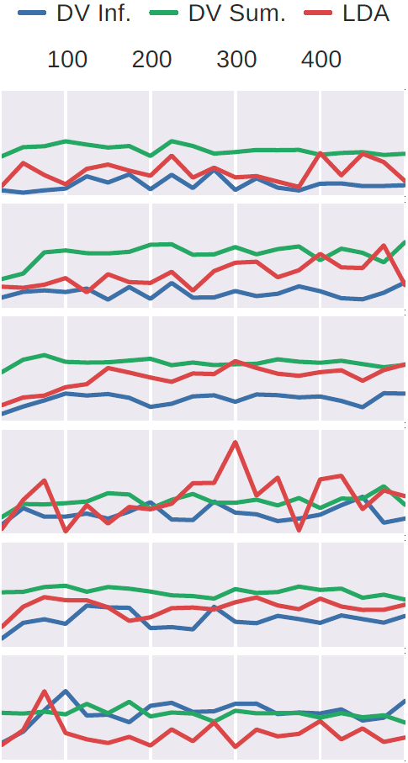
Preliminary Study
Results: Accuracy
ArgoUML v0.22
ArgoUML v0.24
ArgoUML v0.26.2
JabRef v2.6
jEdit v4.3
muCommander v0.8.5
ICSME’15 ERA
Notes:
DV Inf: Document level
DV Sum: Word level
LDA
MRR: Higher and flatter is better
Accuracy Result: Generally better, need to investigate tuning

Slide 10
Related Work
Deep Learning in SE
White, Vendome, Linares-Vásquez, Poshyvanyk, “Toward deep learning software repositories,” MSR 2015.
Positional Proximity in FLTs
Hill, Sisman, Kak, “On the use of positional proximity in IR-based feature location,” CSMR 2014.
Mining Synonyms from Source Code
Howard, Gupta, Pollock, Vijay-Shanker, “Automatically Mining Software-based, Semantically-similar Words from Comment-code Mappings,” MSR 2013.
ICSME’15 ERA

Slide 11
Future Work
Parameter selection/tuning
Query recommendation/refinement
ICSME’15 ERA

